Slide 1
Location for New Pet Store in Toronto
Data science Capstone final assignment

Slide 2
Business Problem
Where should we open up a new Pet Store in Toronto?
We don’t want to simply open up a Pet Store in neighborhoods that have many existing pet stores as the supply may not already match the current demand.
Hypothesis: can we use venue data from Foursquare to identify neighborhoods that may characteristics that are suitable for a new pet store but currently does not have many pet stores?

Slide 3
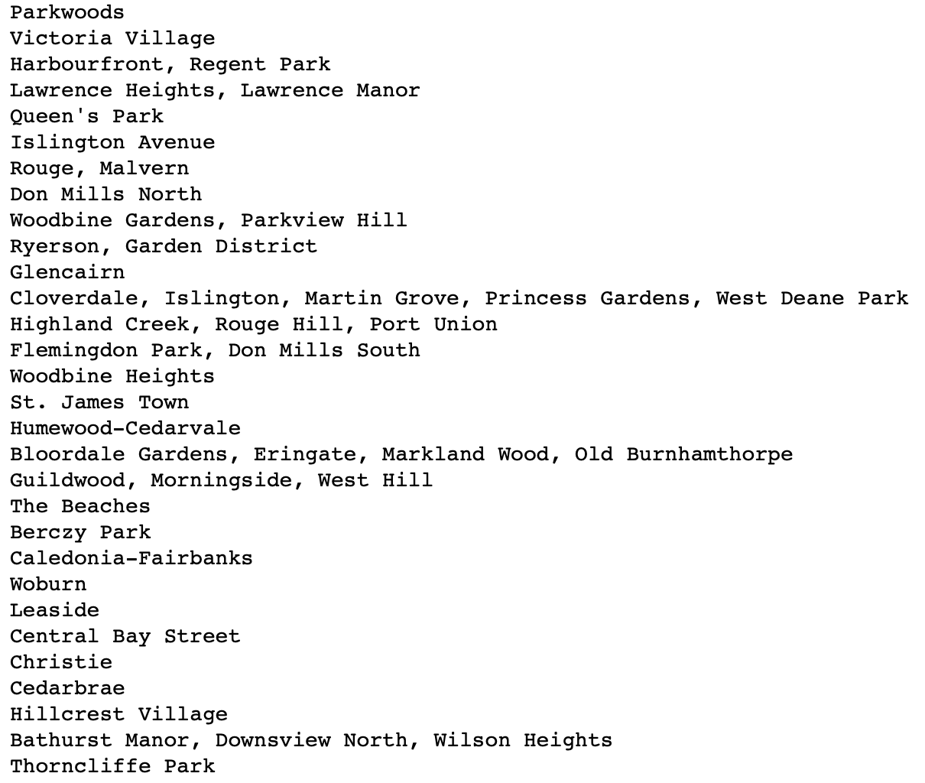
Neighborhood Data
Neighborhood data is gathered from Wikipedia: https://en.wikipedia.org/wiki/List_of_postal_codes_of_Canada:_M

Slide 4
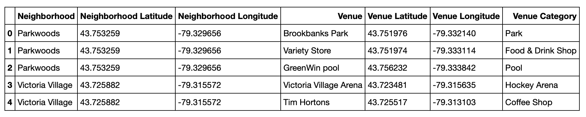
Venue Data
Data for the venue types in Toronto are gathered from FourSquare:

Slide 5
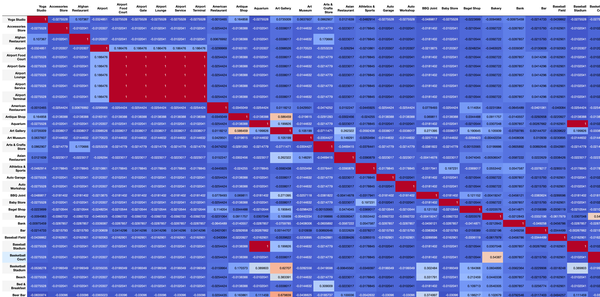
Correlation
We will use venue data from Foursquare to identify venues are often located near pet stores. These venues will serve as a proxy for the type of demographic that are well served by a pet store. We will identify these venues by calculating the correlation with instances of pet stores.

Slide 6
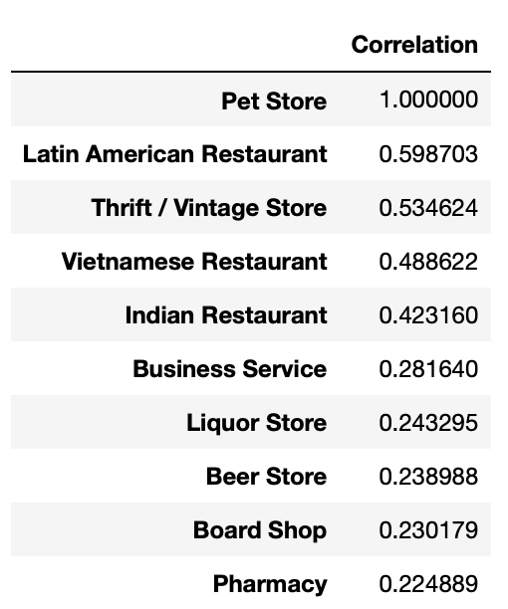
Venues related to Pet Stores
The venues that often located in the same neighborhoods with Pet Stores are:

Slide 7
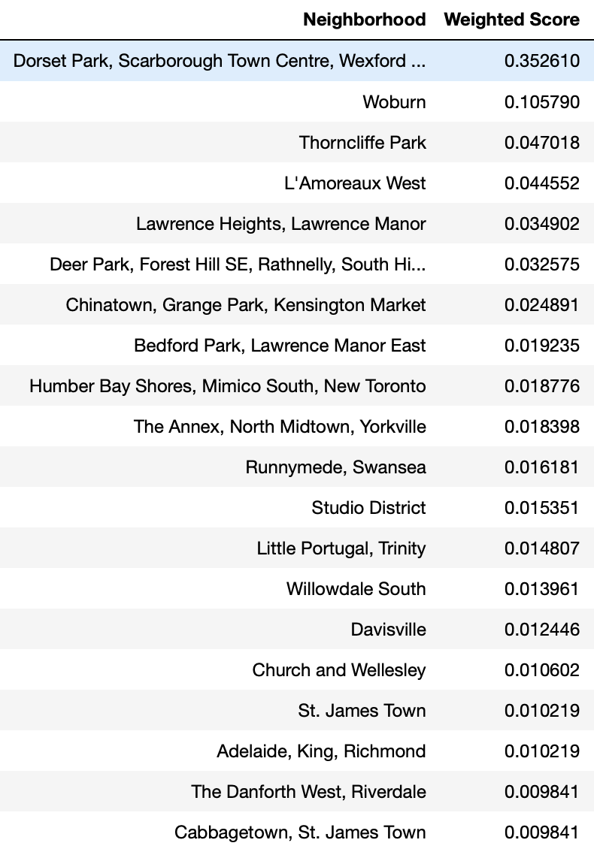
Which Neighborhood fits our Target?
Based on the types of venues that we identified these are the neighborhoods display our target characteristics:

Slide 8
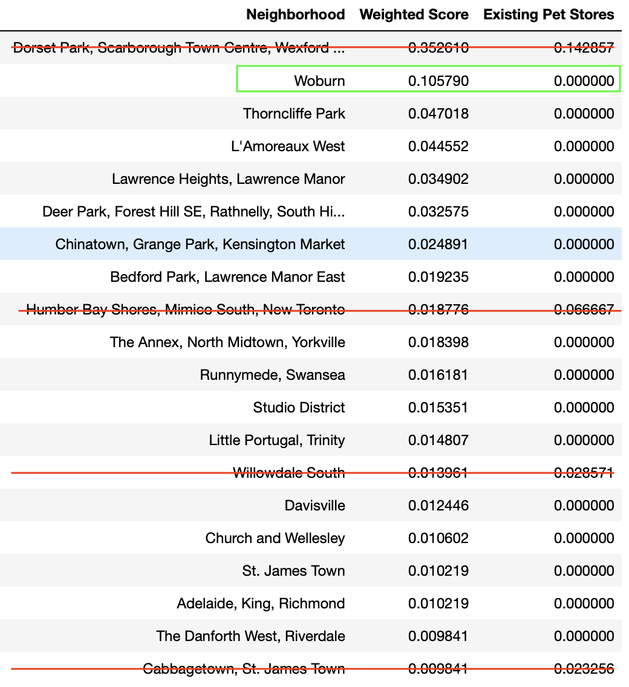
Which Neighborhood is currently undersupplied?
Although we have know which neighborhoods are best suited for pet stores, some of these neighborhoods may already have many existing pet stores.

Slide 9
Our Ideal Neighborhood
The neighborhood that has required characteristics and currently does not have many pet store is:
WoBurn!

